Slide 1
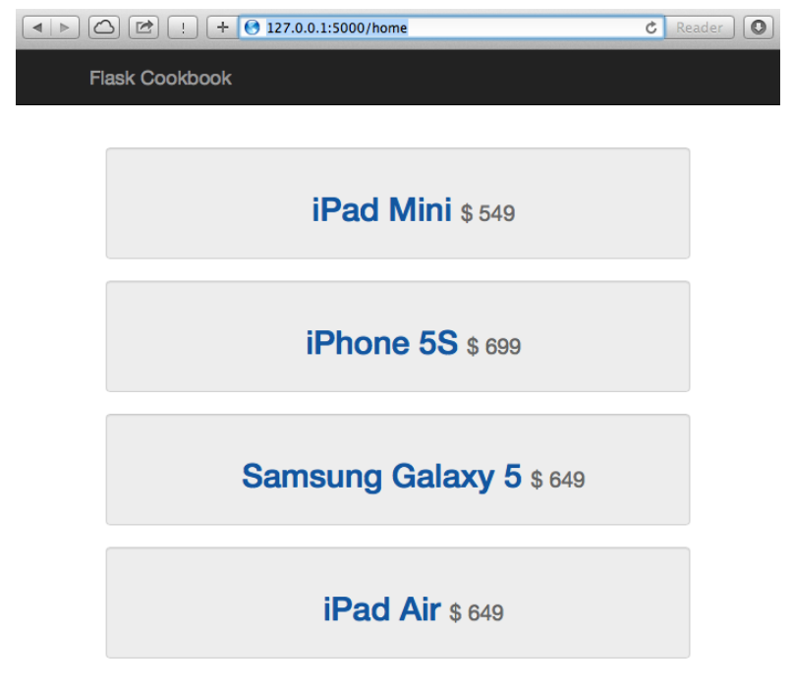
Login Page
Driving License Management System
Login
Registration

Slide 2
Registration Page
Driving License Management System
Login Page
Applicant login:
User ID
Login
Password
Registration
Login

Slide 3
Registration Page
Driving License Management System
Staff Login Page
Staff login:
User ID
Login
Password
Registration
Login

Slide 4
Registration Page
Driving License Management System
Applicant Registration
Applicant Registration:
First Name
Login
Email
Middle Name
Last Name
Date of Birth
Registration
Mobile Number
Password
Confirm Password
Security Question
Answer
Sign Up

Slide 5
Home Page – Applicants
Driving License Management System
Home Page
Book a Trial
View Results
Logout

Slide 6
Registration Page
Driving License Management System
Booking a Trial
Application form:
Login
Your application ID is: XXXXXX
Select Location
Select Date
Confirm

Slide 7
Cancel a Trial Page
Driving License Management System
Cancel a Trial
Application form:
Login
Your application ID is: XXXXXX
Selected Location
Selected Date
Cancel this trial

Slide 8
View Result Trial Page
Driving License Management System
View Results
Results of the Trial:
Login
Your application ID is: XXXXXX
Selected Location
Selected Date
Trial Status & Results
Back to home

Slide 9
Book a Trial Page – Applicants
Driving License Management System
Application Form:
Application Number: (Assigned by System)
Applicant ID: (Assigned by System)
Name:
National ID:
Date of application:
Booking date: (Select the date)
Submit

Slide 10
Cancel a Trial Page – Applicants
Driving License Management System
Application Number: (Assigned by System)
Applicant ID: (Assigned by System)
Name:
National ID:
Date of application:
Booking date: (Selected the date)
Cancel

Slide 11
View Result – Applicants
Driving License Management System
Application Number: (Assigned by System)
Applicant ID: (Assigned by System)
Name:
National ID:
Date of application:
Booking date: (Selected the date)
Status: Approved / Rejected / To be Reviewed
Back Home

Slide 12
Home Page – Admin Staff
Driving License Management System
Staff Home Page
Applicants Bookings Review
View History
Logout

Slide 13
Applications review – Admin Staff
Driving License Management System
Applications Verification
Application Number: 0001
Applicant ID:
Name:
National ID:
Date of application:
Approve
Reject
Application Number: 0002
Applicant ID:
Name:
National ID:
Date of application:
Approve
Reject
Application Number: 0003
Applicant ID:
Name:
National ID:
Date of application:
Approve
Reject
Back home

Slide 14
Applications history – Admin Staff
Driving License Management System
Applications History
Application Number:
Applicant ID:
Name:
National ID:
Date of application:
Status: APPROVED
Application Number:
Applicant ID:
Name:
National ID:
Date of application:
Status: REJECTED
Application Number:
Applicant ID:
Name:
National ID:
Date of application:
Status: APPROVED
Back home

Slide 15
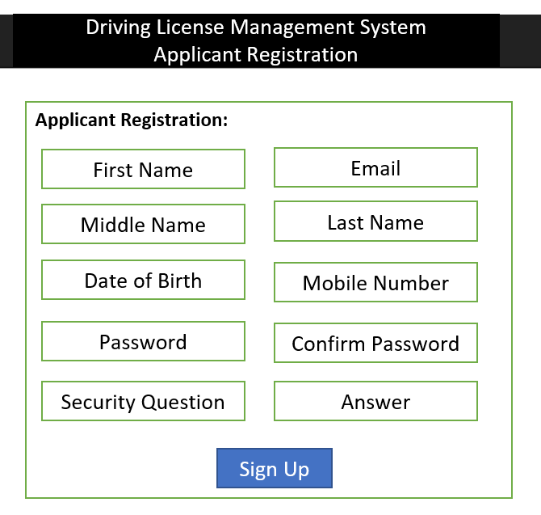
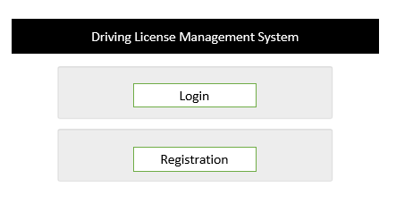
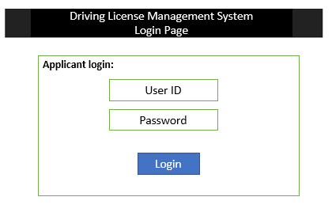
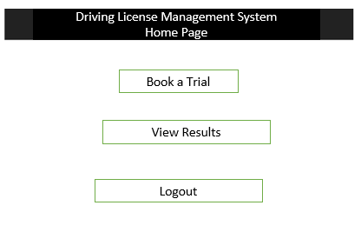
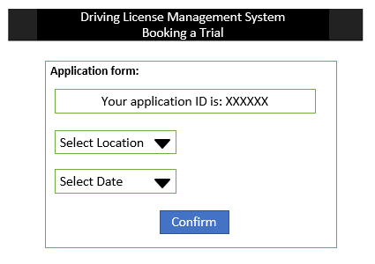
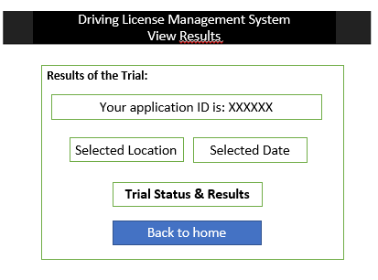
LANDING PAGE
REGISTRATION PAGE
LOGIN PAGE
The landing page is the first page of the system. Consist of a basic Identification and Login & Registration buttons.
The Registration page is the page that the applicant uses to register in the system..
The login page is the page that the applicant uses to login in the system..
HOME PAGE
BOOKING PAGE
VIEW RESULTS PAGE
The home page is the first page of the system once the user has logged in. Shows the options of booking a trial and view history.
The booking page is the page where the user is going to book an appointment.
The Results page is the page where the user is going to review the result of a trial

Slide 16
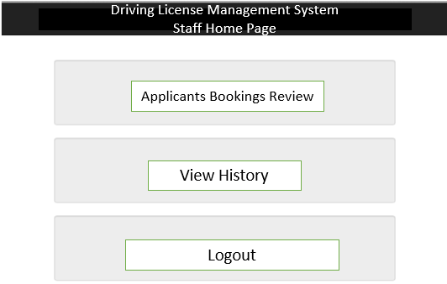
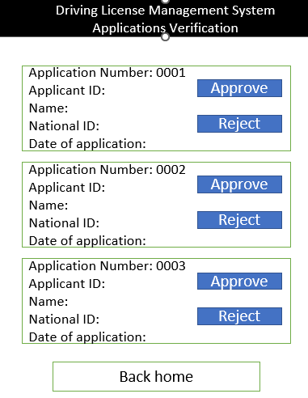
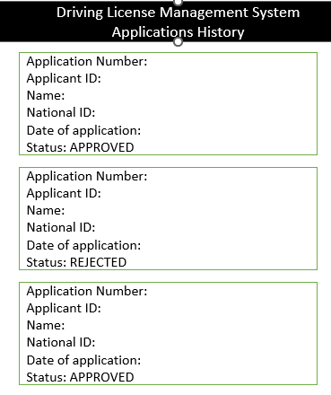
LANDING PAGE
HOME PAGE
LOGIN PAGE
The landing page is the first page of the system. Consist of a basic Identification and Login & Registration buttons.
The home page is the first page of the system once the staff has logged in. Shows the options of booking review and view history.
The login page is the page that the staff login in the system..
BOOKING REVIEW PAGE
VIEW HISTORY PAGE
The booking review page is the page where the staff is going to review and register the trial result of an appointment.
The view history page is the page where the staff is going to see appointment history.

